Slide 1
Clothing Categorizing
Supervised by: Eng. Khloud Al Jallad
By: Ayoub Alkak

Slide 2
Introduction
This project is a neural network based project using deep learning to categorizing clothes to 10 categories

Slide 3

01
IMPORTING
LIBRARIES AND DATASET

Slide 4
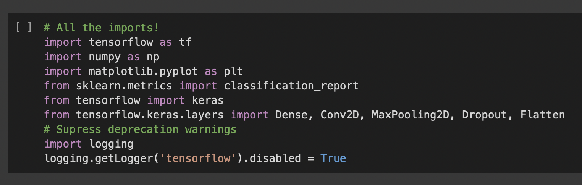
Importing Libraries
Using Logging to disable any warning from tensorflow

Slide 5
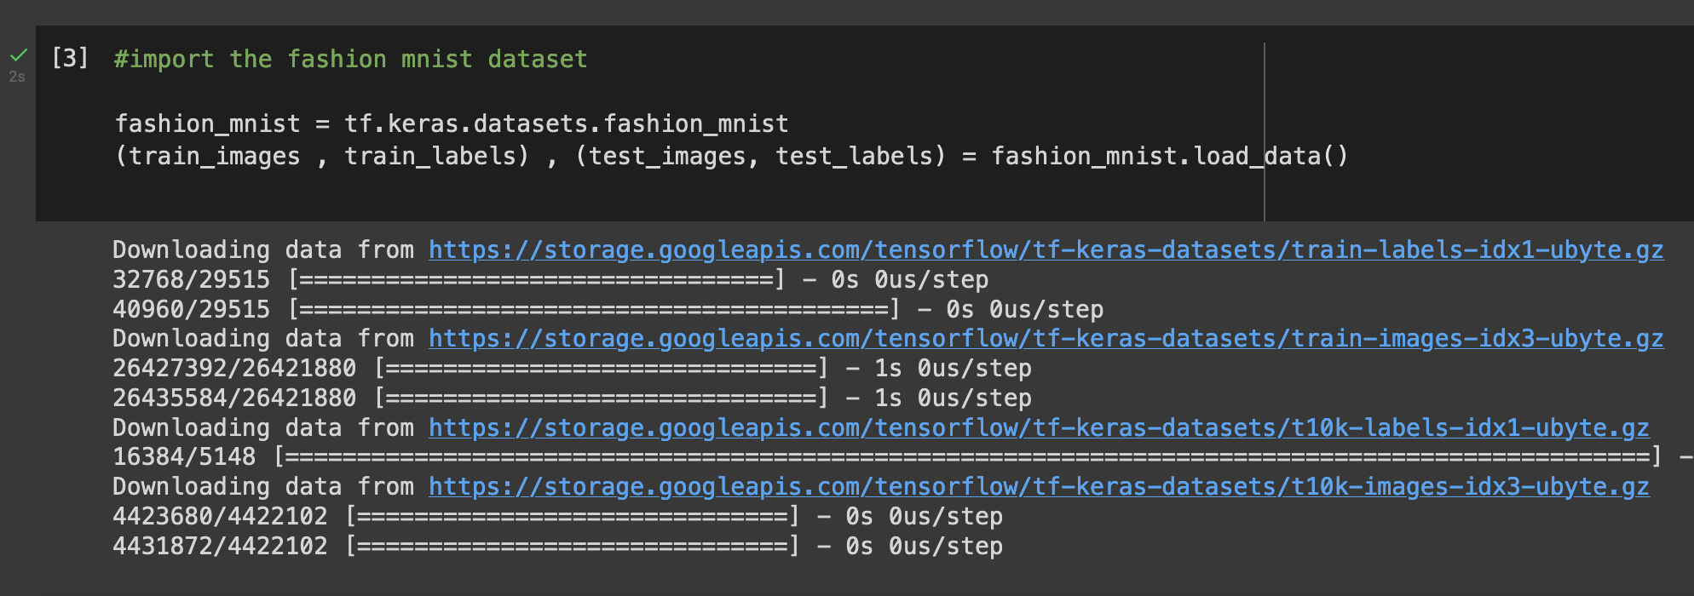
Importing The Dataset
This dataset is from keras

Slide 6
02
DESCRIBING
THE DATASET

Slide 7
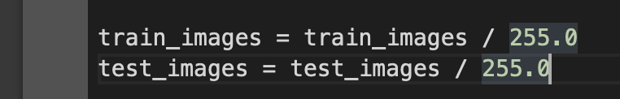
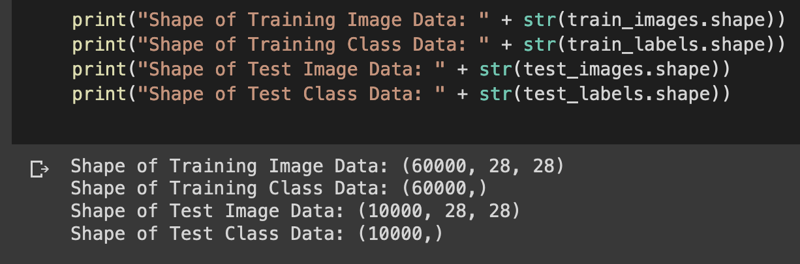
Describing The Dataset
Each element in this dataset is a pixel value of 0 to 255
So normalizing the element to values between 0 and 1 is better

Slide 8
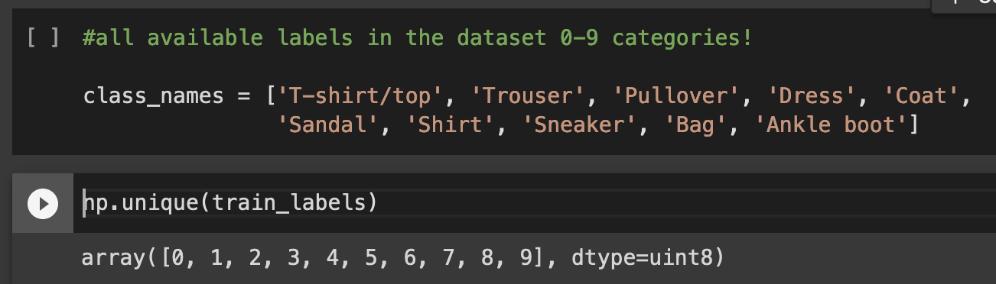
Describing The Dataset
After researching, I found that this dataset have 10 different labels

Slide 9
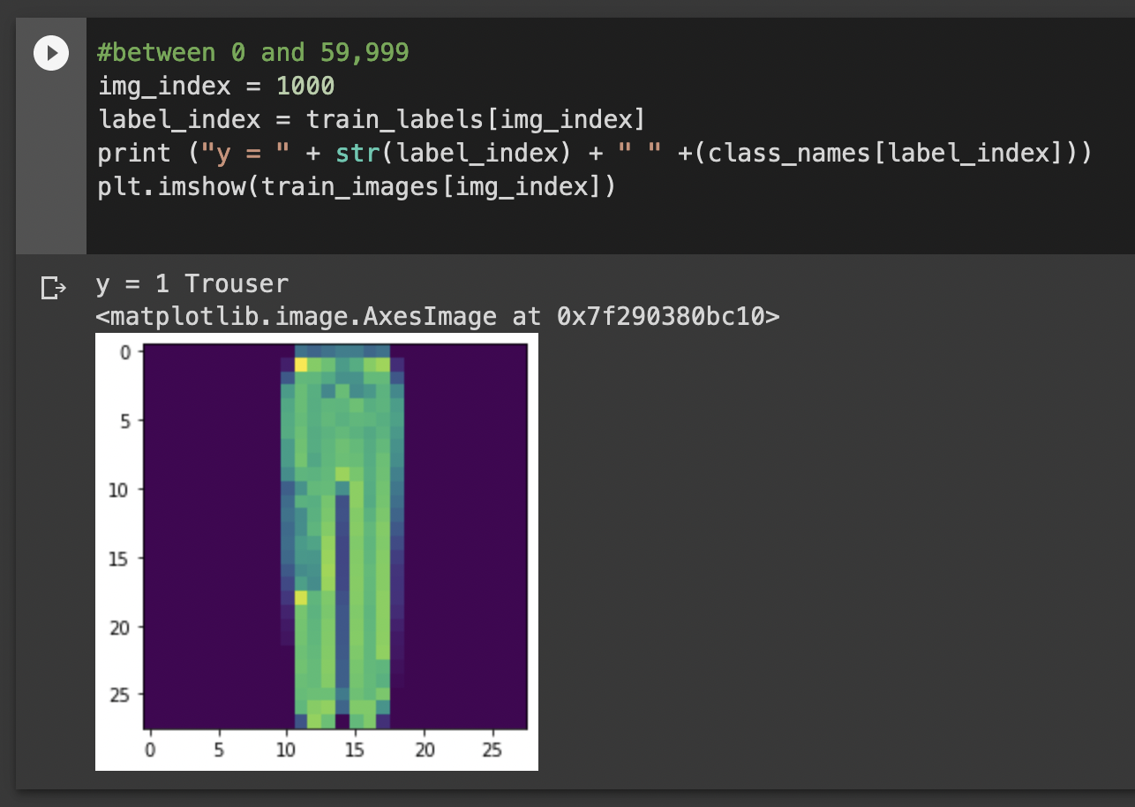
Describing The Dataset
Showing a train image from the dataset

Slide 10
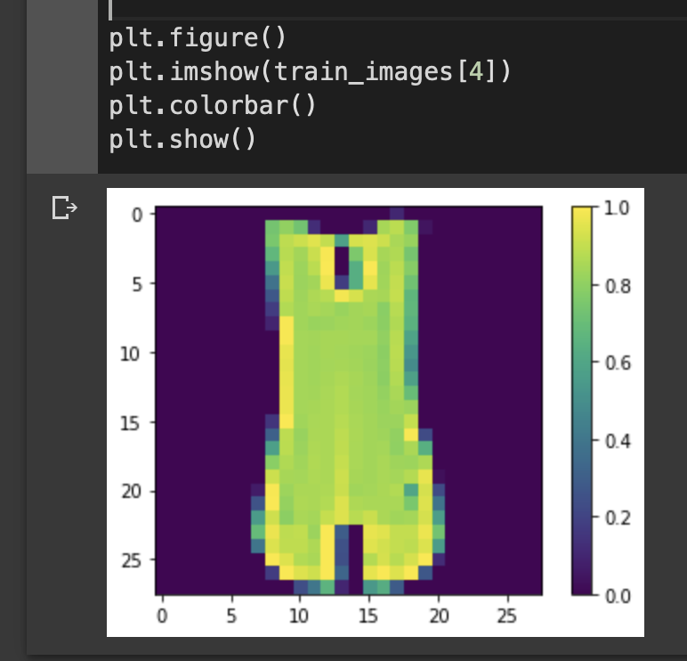
Describing The Dataset
Making a colour bar to see the colours values of the pixels index

Slide 11
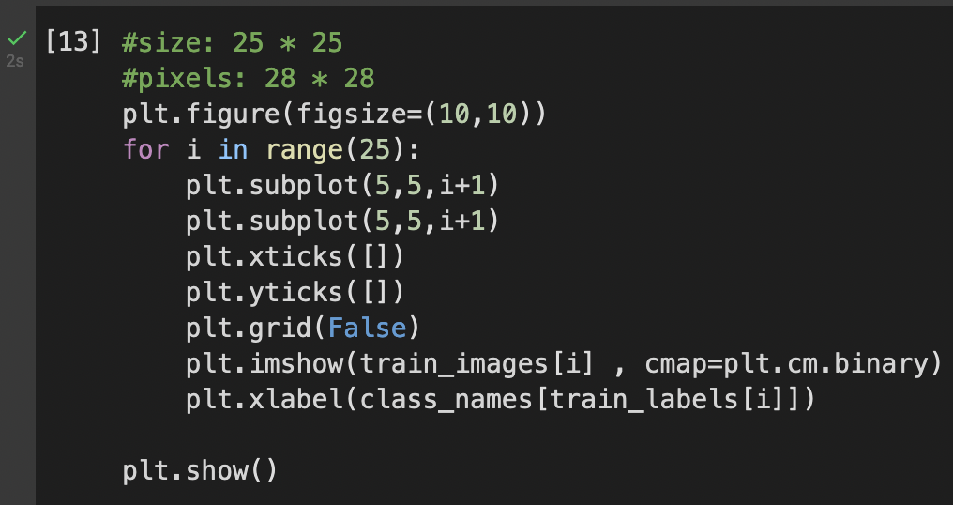
Describing The Dataset
Visualise first 25 images from training data

Slide 12
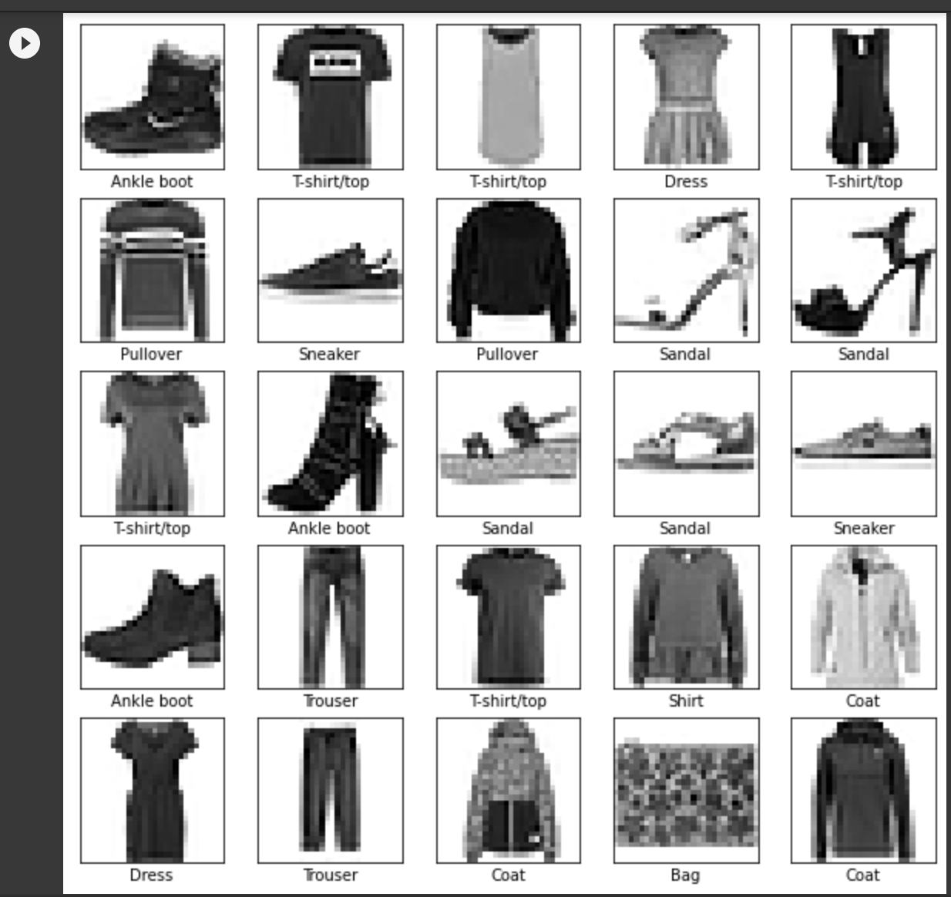
Describing The Dataset

Slide 13
03
RESHAPING
DATASET TO USE IN THE MODEL

Slide 14
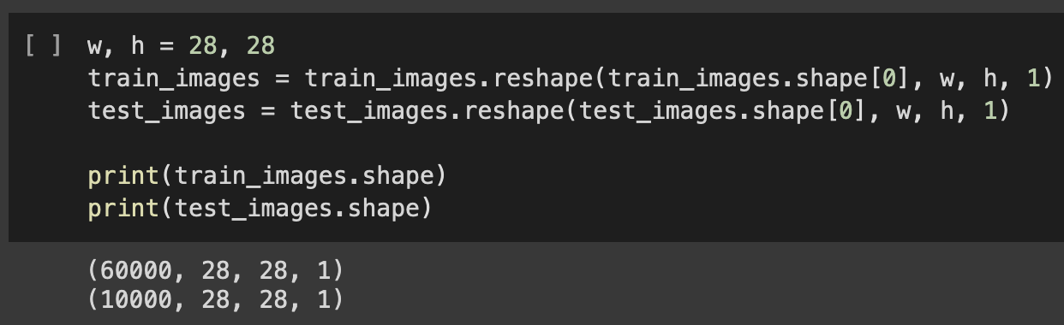
Reshaping The Dataset

Slide 15
04
BUILDING MODELS
RESEARCHING AND BUILDING A PROPER MODEL
AND TRAINING

Slide 16
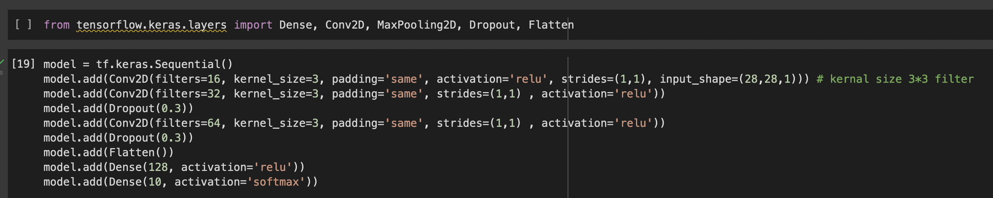
Importing the layers & Building first model
We choose CNN because is best way to extract features from pictures, in this model we didn’t use max pooling

Slide 17
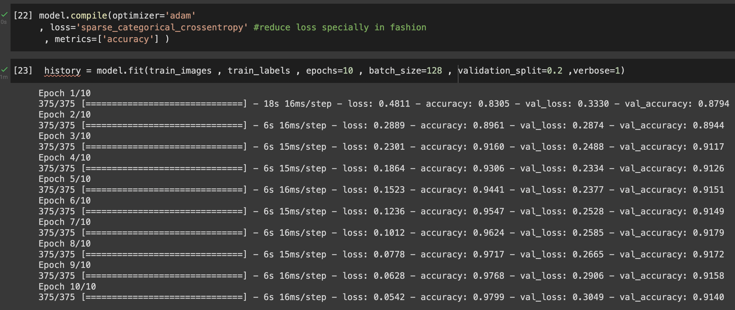
Compiling and training the model
)

Slide 18
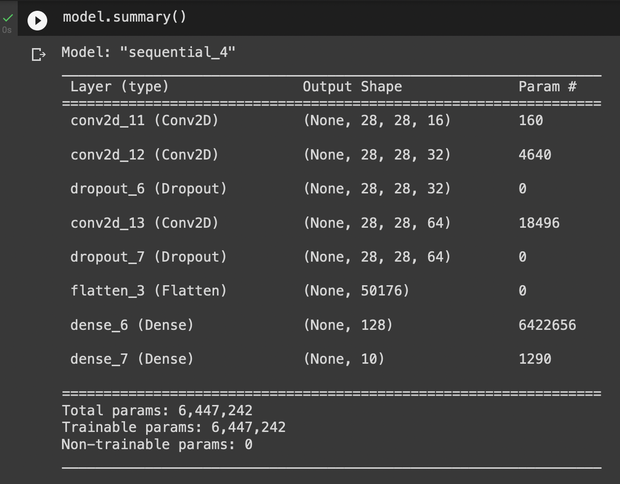
Model Summary

Slide 19
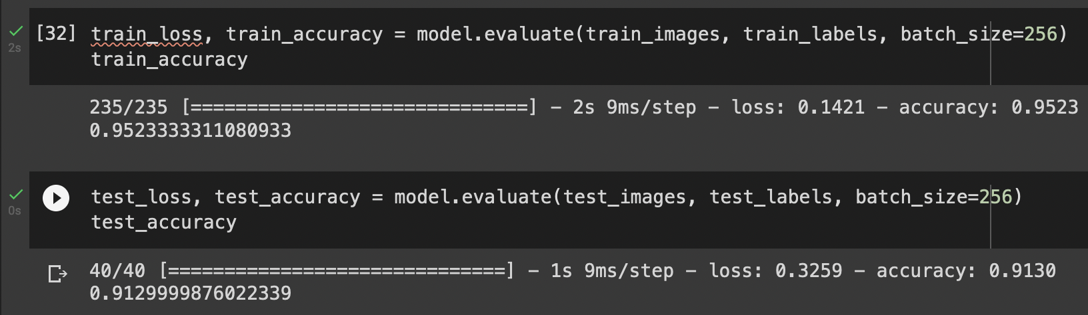
Comparing Test and Train Acc
There is a little overfit and we can do better

Slide 20
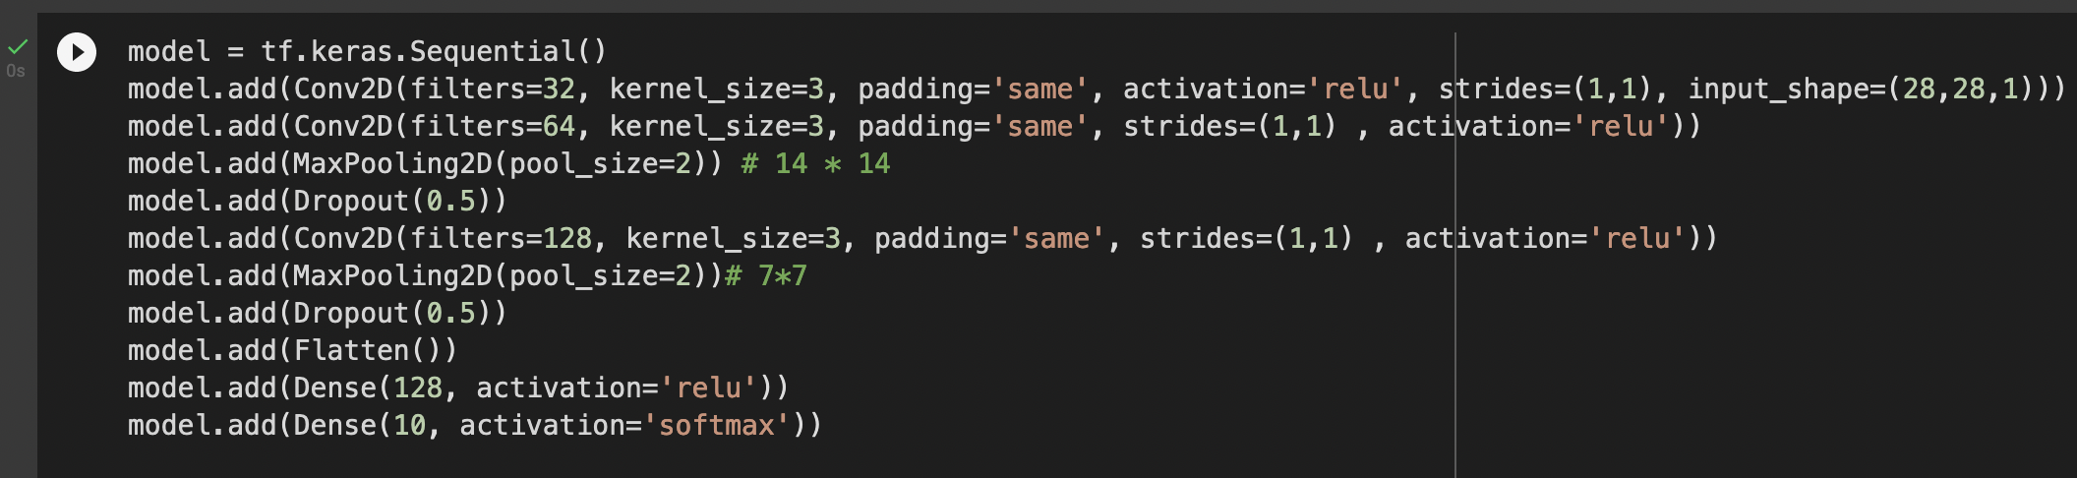
Building a new Model
Changing the filter values and adding two maxpooling layers

Slide 21
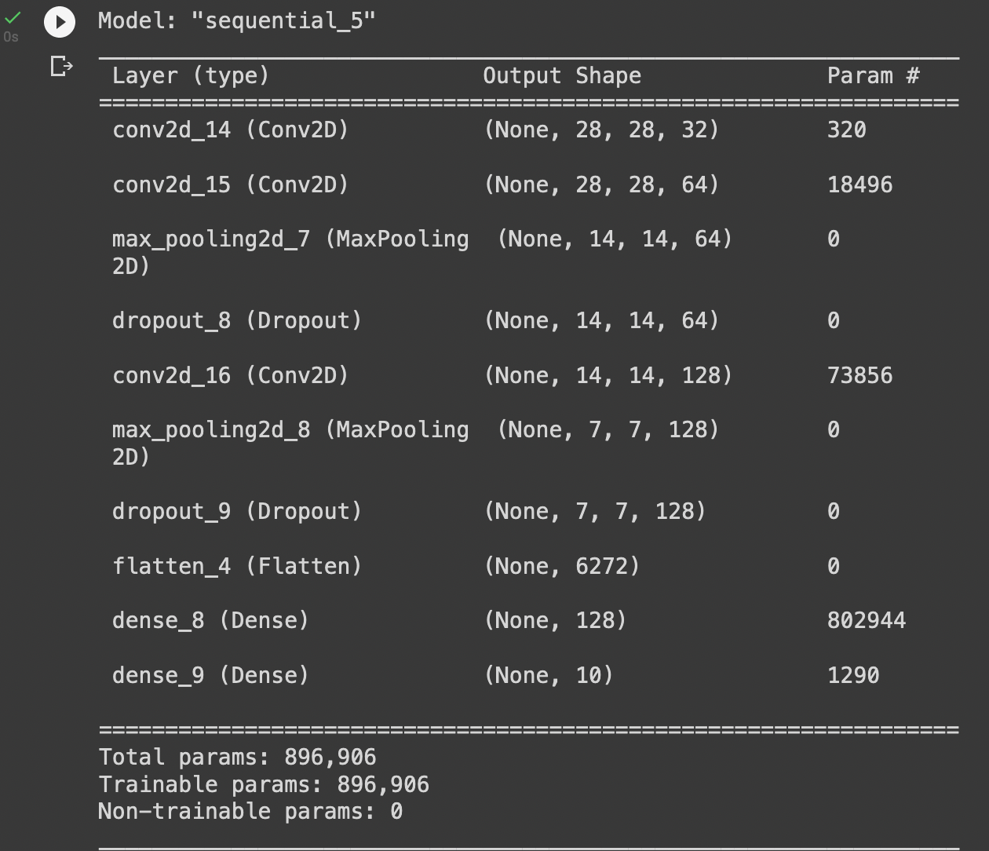
New Model Summary

Slide 22
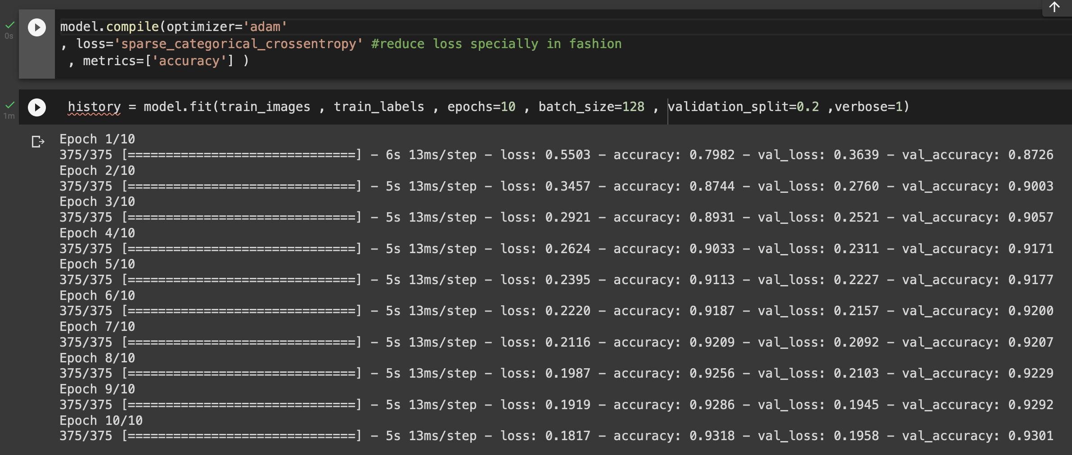
Compiling and training the new model
)

Slide 23
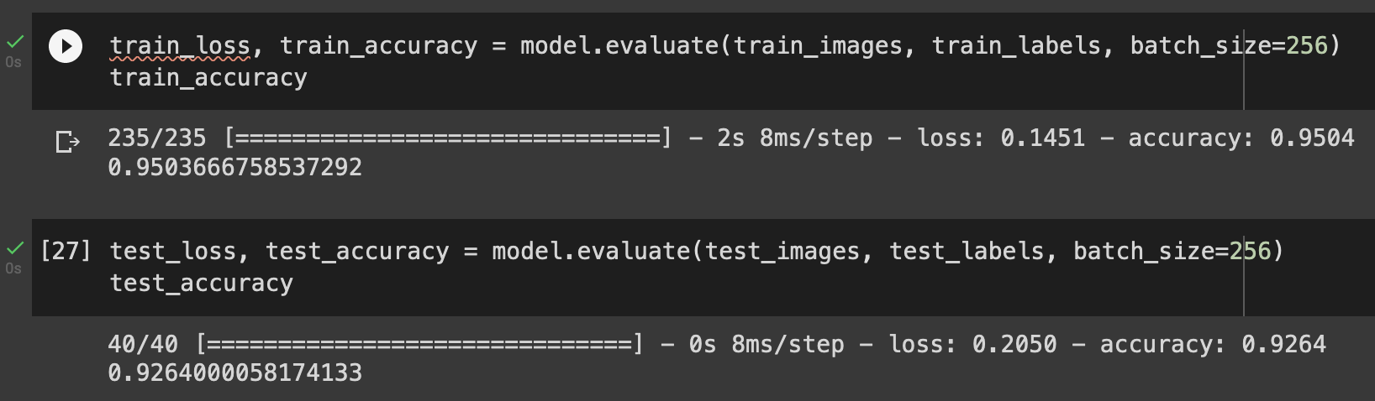
Comparing Test and Train Acc
The overfit has been decreased alittle

Slide 24
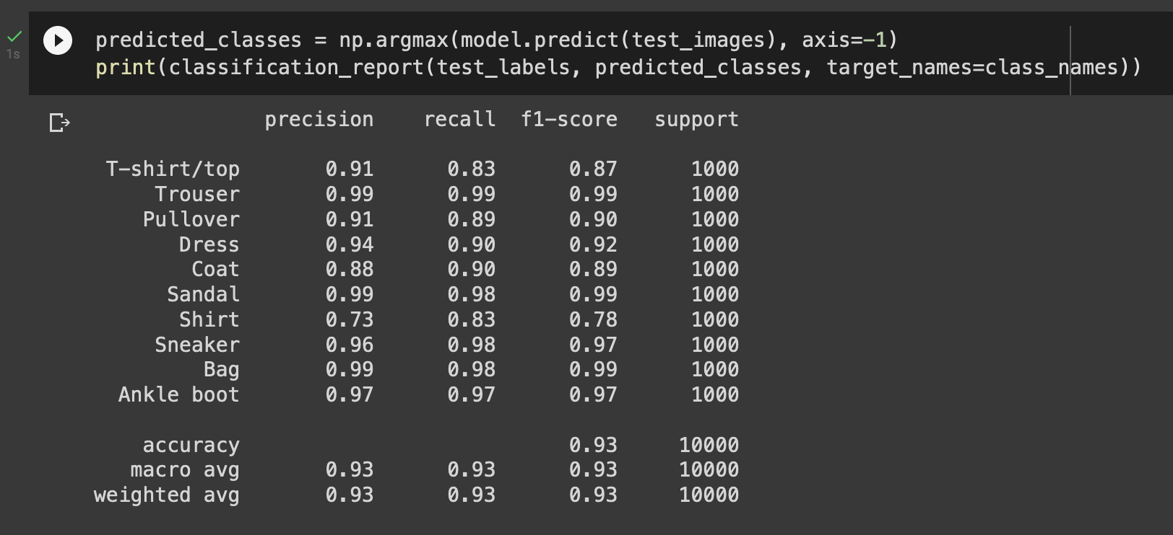
Classification Report

Slide 25
05
PLOTING
VISUALING IS ALWAYS BETTER

Slide 26
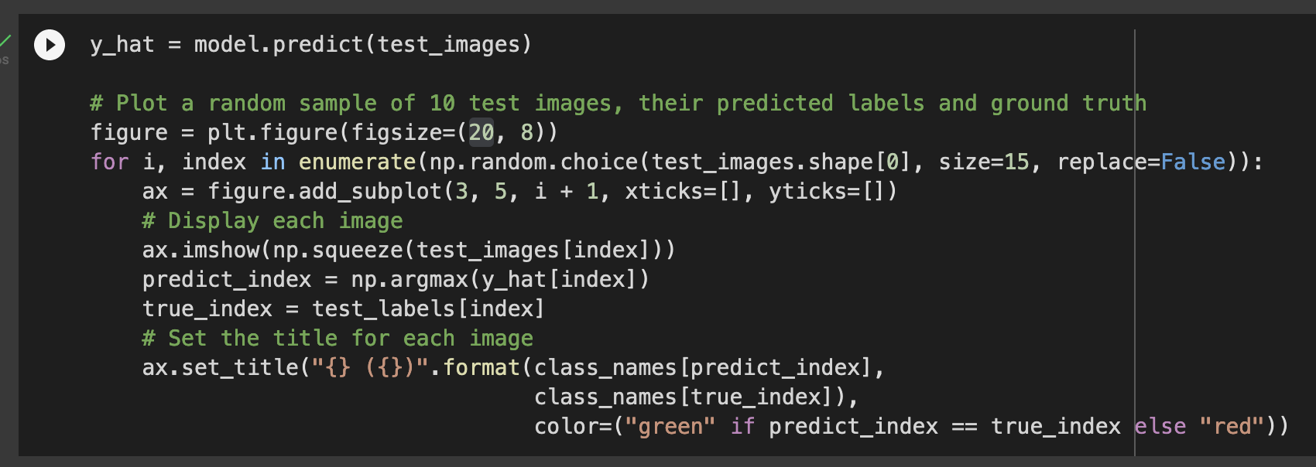
Plot a random sample of 10 test images

Slide 27
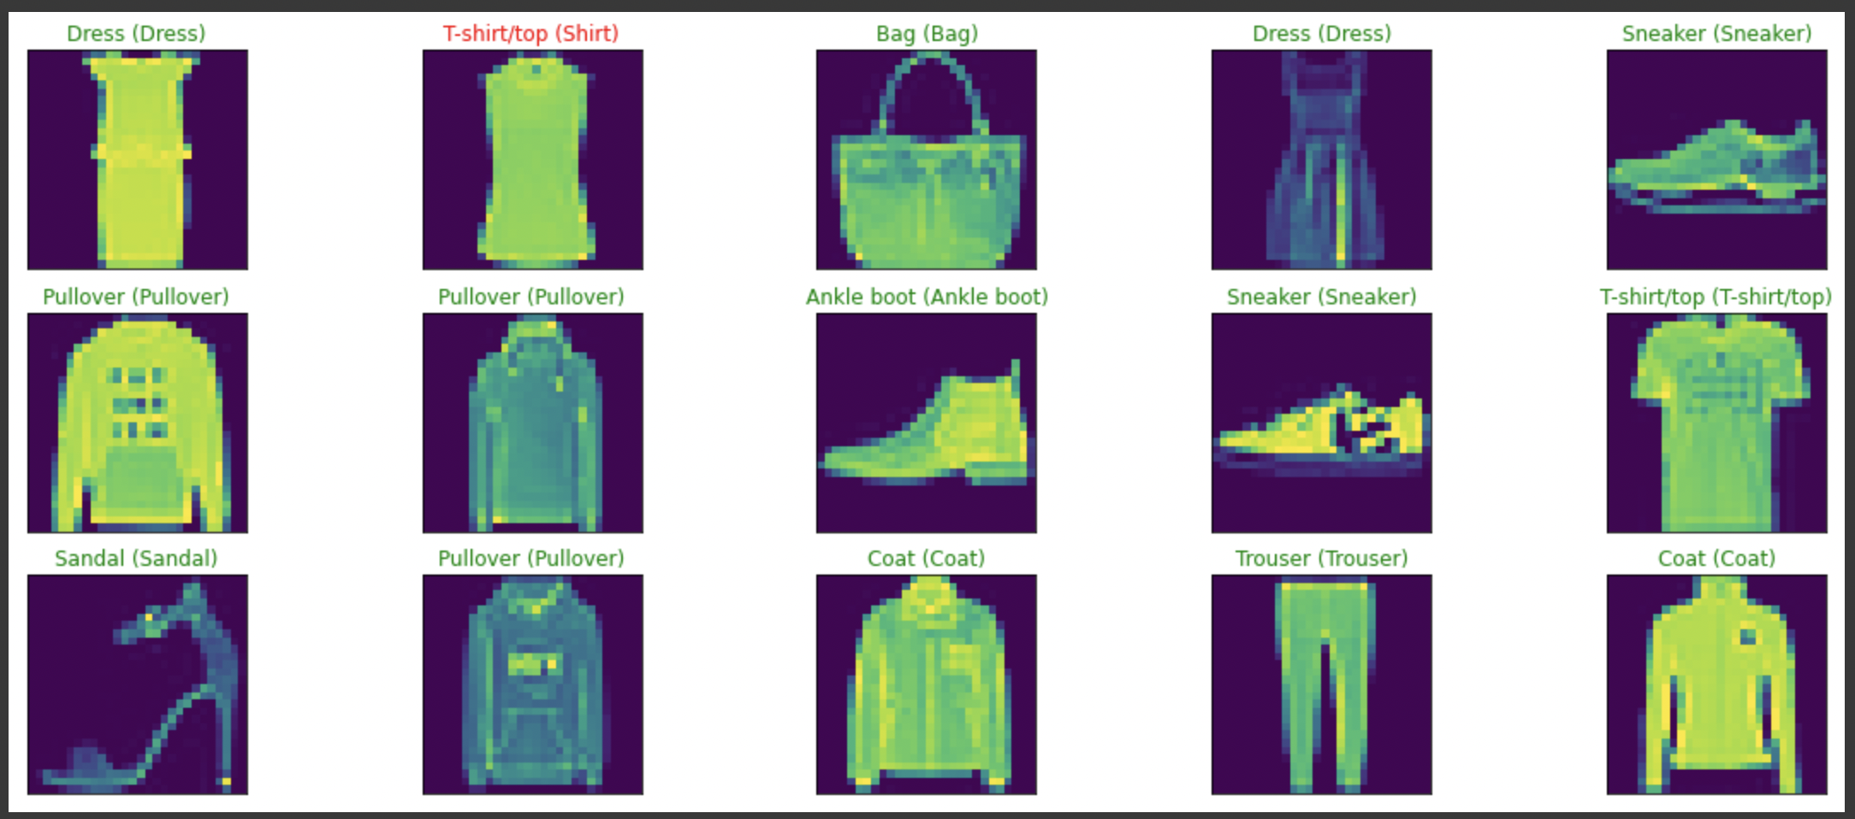
if it's green : the prediction of the index correct
if it's red : the prediction of the index incorrect

Slide 28
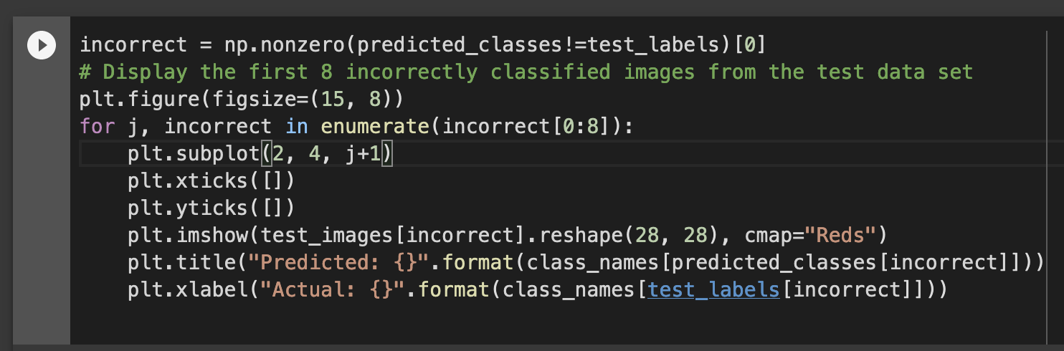
View examples of incorrectly classified test data

Slide 29
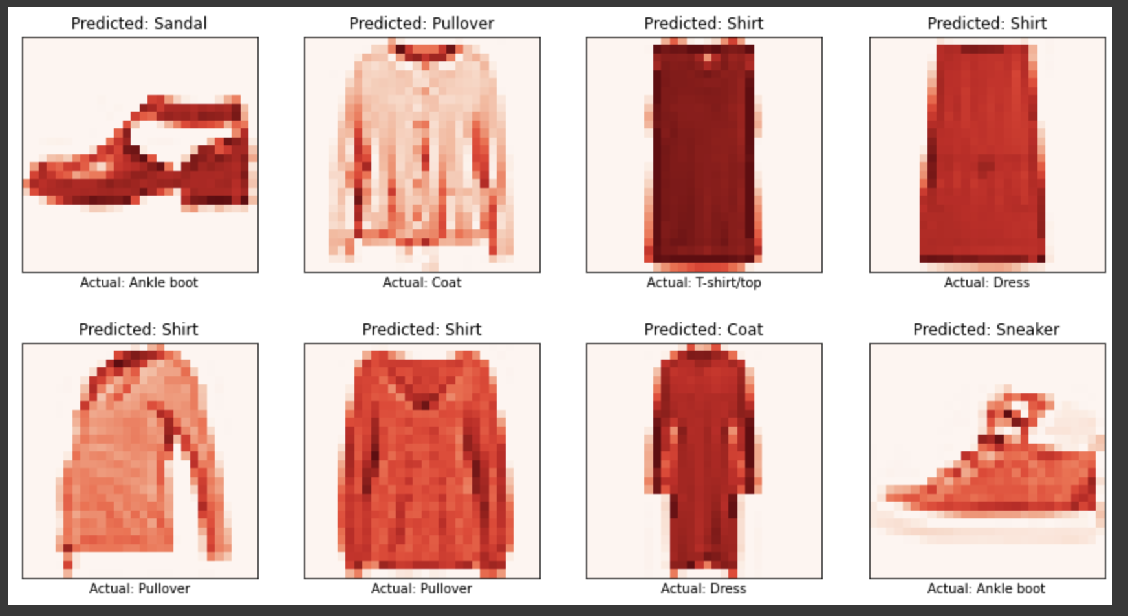

Slide 30
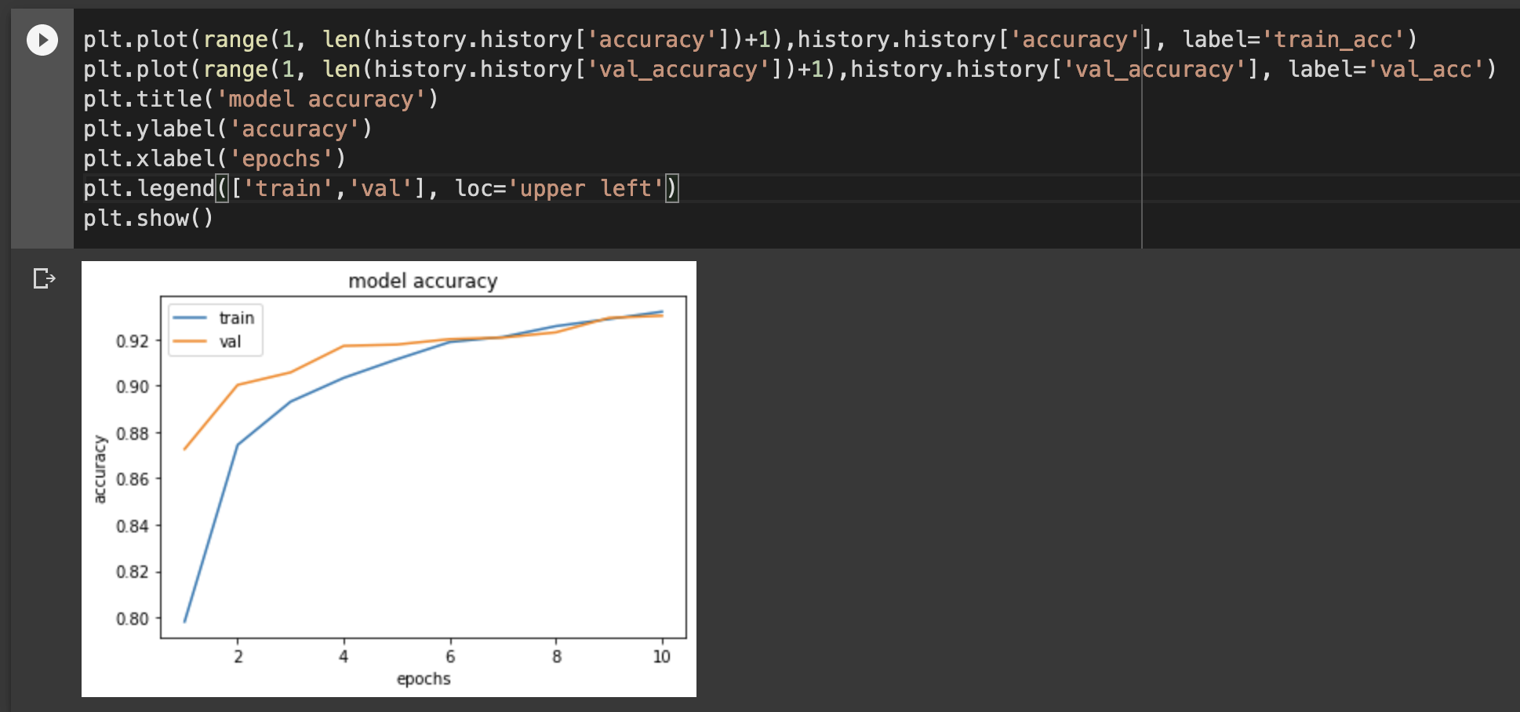
Plotting The accuracy and validation accuracy

Slide 31
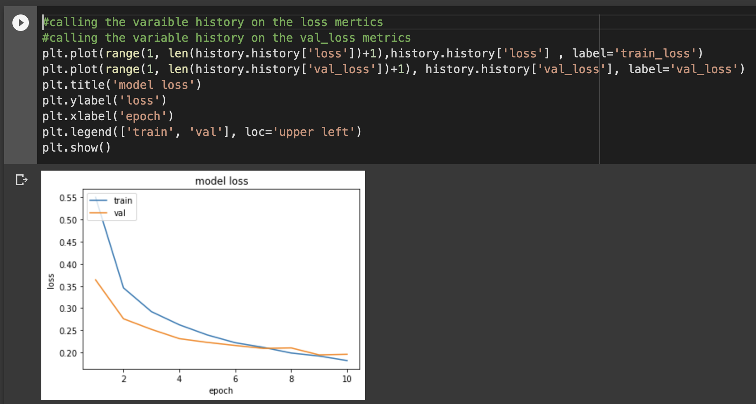
Plotting The Loss and Validation Loss

